Slide 1
The Emissions Trading System of Mexico: Key milestones for 2019, latest developments for 2020, and prospects for Mexico’s ETS post-2020.
CDMX, 2020

Slide 2
Climate Change Policy Framework
National development plan
2019 – 2024
National objectives
Sectoral programs
General Climate Change Law is a live instrument
We have been working on:
Tracking system (Registry)
Review of preliminary bases and recognition of pending issues to be developed.
Compensation Protocols and Early Actions Program as well as Market related data handling and Market monitoring.
General Law on Climate Change
National Climate Change Strategy
Special Program on Climate Change
National Adaptation Policy
Subnational Climate Change Programs
Climate Policy Instruments
Emissions Trading System
National Inventory of Emissions of Gases and Greenhouse Compounds
National electromobility strategy
Mid-Century Strategy

Slide 3
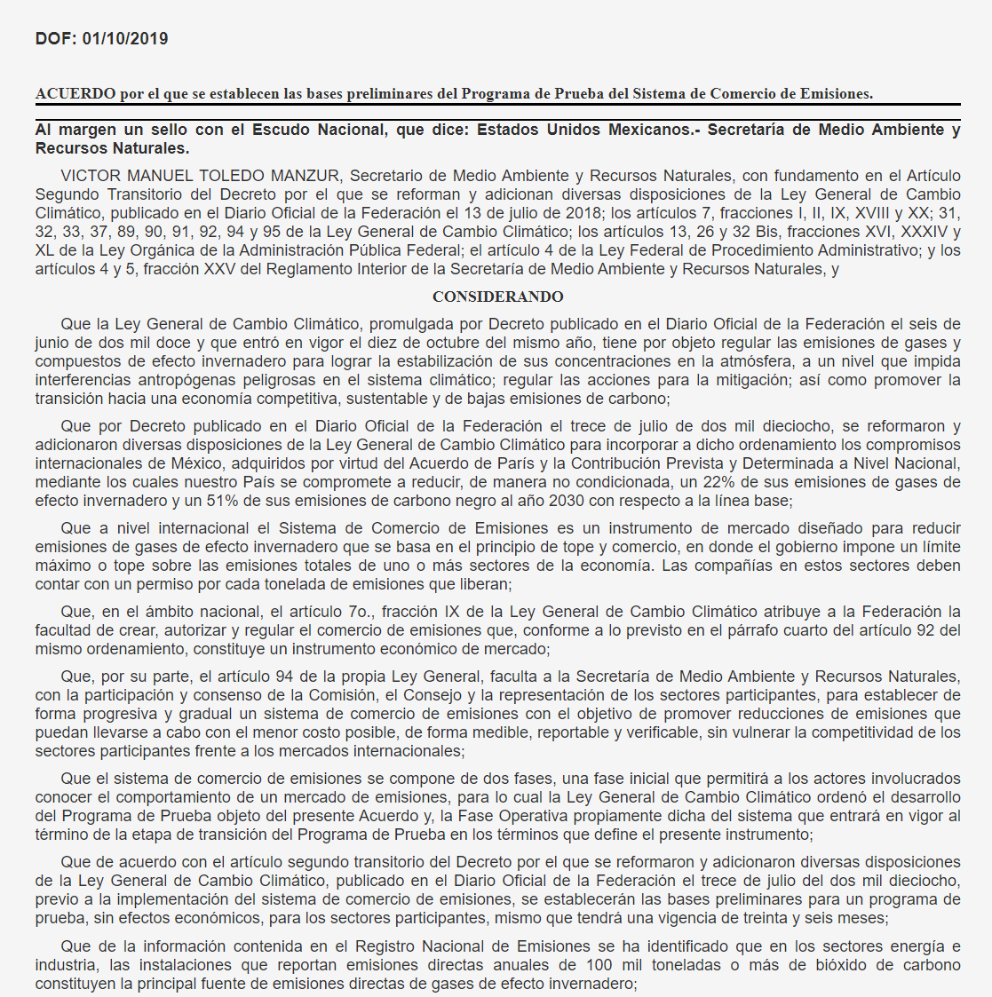
Climate Change Law – ETS Amendments
Published on July 13th, 2018
SEMARNAT is mandated to implement an ETS
36 months pilot prior to operational phases
No economic impacts
No impact on competitiveness
Regulation must be prepared for pilot phase (2019)

Slide 4
Mexico ETS Pilot Phase Regulation
Published on October 1st, 2019
Mandatory
Compliance periods of 1 year (art. 6)
Scope (Energy and Industry) (art. 7)
Threshold for participation (art. 8)
Flexibility mechanisms (art. 33-39) banking y offsets
MRV requirements (art. 40-45)
Centralized registry (art 28)
Allocation (art. 16) by installation
Key considerations
Covered sectors : Energy and Industry
Allocation: free, based on grandfathering to all participants (to be reduced after pilot) Based on historic emissions
Offsets. Usage limit for compliance (up to 10%)

Slide 5
2020
06
Studies
Mix of policies, co-benefits, auctions
07
Pilot Evaluation
Evaluation criteria
Transition into
formal phase
08
14 representatives and 4 observers from:
8 – Non-Gvt (8 Business chambers & Bankers association),
4 Gvt (Ministries of Environment, Energy, Finance and Economy),
2 Technical experts (INECC & CONAFOR)
2 Observers (Civil Society and Academia, 2 from each)
05
Training
Capacity building for regulated and interested parties
04
Advisory Committee
Formation of the Committee and the evaluation working group. Regulation, work plan
03
Offset Protocols
Offsets program, criteria, procedures, verification
01
02
Internal procedures
Registry
Development of internal procedures for the reception, analysis and storage of information in DGPCC
Development of monitoring system, tests, maintenance

Slide 6
ETS Timeline
Pilot Phase
Operational Phase
2019
2020
2021
2022
2023
2030
Transition year
EVALUATION
ETS Pilot Phase REGULATION
(October 1, 2019)
CAP & Allocation Plan
(November 27, 2019)
Operational Phase Regulation

Slide 7
Thank You
mexico.ets@semarnat.gob.mx
www.semarnat.gob.mx
https://cambioclimatico.gob.mx
https://www.gob.mx/semarnat/acciones-y-programas/programa-de-prueba-del-sistema-de-comercio-de-emisiones-179414

