Slide 1
leveraging carbon pricing mechanisms to Scale investments in nature
© Robin Moore/iLCP
Maggie Comstock
Senior Director, Climate Policy
mcomstock@conservation.org

Slide 2
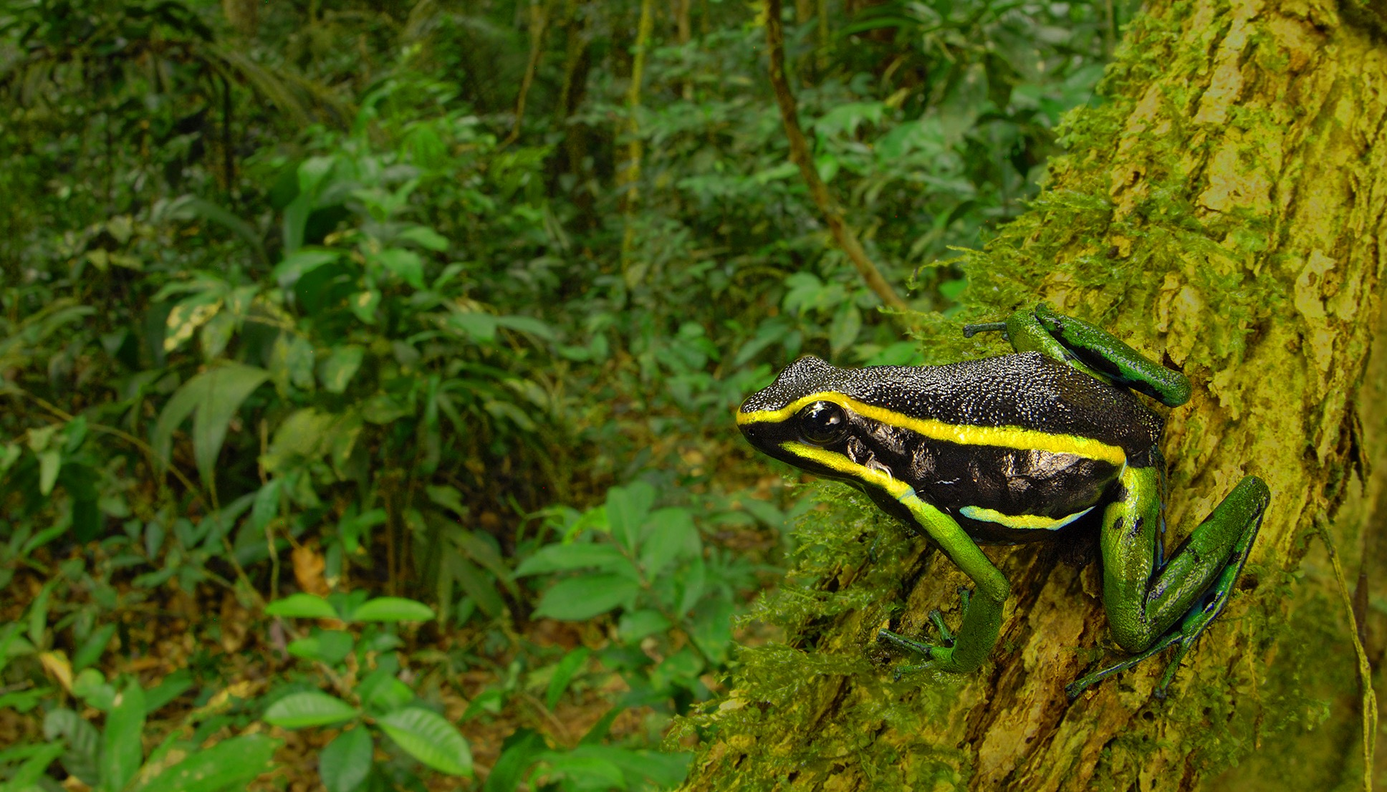
3%
30%
Current investment in NCS is insufficient compared to nature’s contribution to the climate response.
We need policy frameworks that give market value to NCS driving investment demand and incentivizing innovation.
© Trond Larsen
Notes:
Potential for including nature in both carbon markets and carbon taxes

Slide 3
Opportunities for Incorporating Nature in carbon pricing mechanisms
Decades of successes, yet slow to scale up
(1987) First commercial debt-for nature swap
(2001) Over $200m leveraged through conservation trust funds (Global Conservation Fund)
(2005) Impact investing in biodiversity-focused businesses (Verde Ventures)
(2010) $20m forest carbon deal to support protected area in Peru
(2014) Private equity-type of investments in conservation (Althelia)
(2017) $152m first green bond focused on forest conservation (IFC Forest Bond)
(2018) CI Ventures a $30m impact-first investment vehicle
…over $500m deployed over the last decade through various mechanisms
International
Article 6
ICAO
National (LAC)
Colombia
Mexico
Peru
Ecuador
Regional + Subnational Opportunities
Pacific Alliance
Linkages to California
© Kyle Obermann

