Slide 1
A framework for assessing and financing the co-benefits of nature-based solutions in AFOLU projects
Poverty and inequality
Climate crisis
Biodiversity loss
NbS
REDD
BLUE CO2
AFOLU Projects
ARR
Quantify and certify impact
IFM

Slide 2
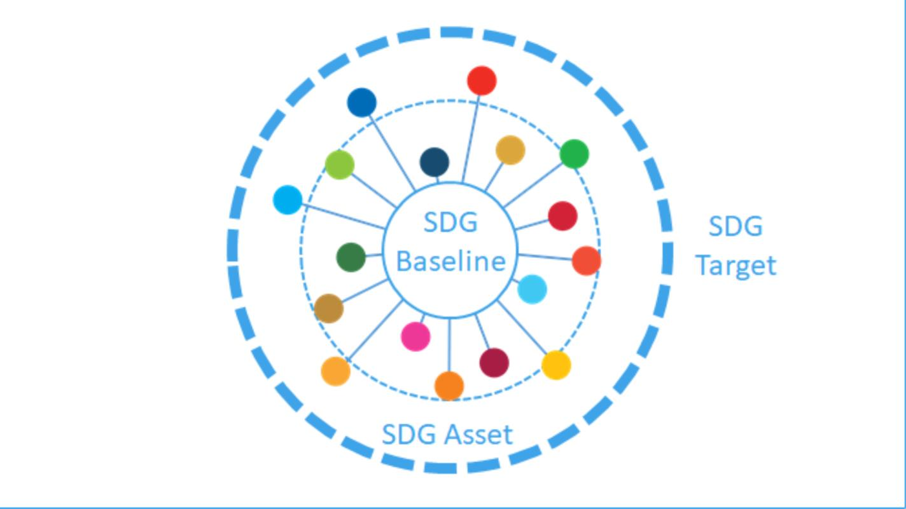
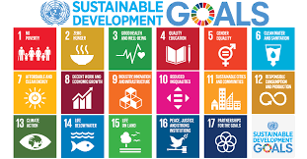
Community-based sustainable projects
Namaxü raises results-based finance through the issuance of sustainability certificates

