Slide 1
13-May-2020
Eastern Africa Alliance on Carbon Markets and Climate Finance
CPLC Africa Working Group Call
Presenter: Bianca Gichangi – Coordinator, Eastern Africa Alliance on Carbon Markets and Climate Finance

Slide 2
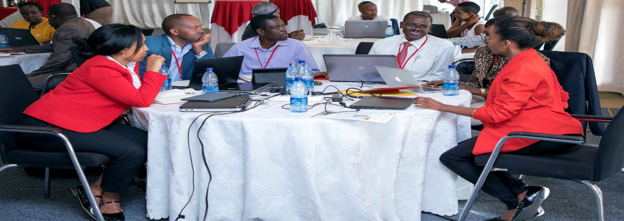
Workshop on carbon markets
About us
The Alliance was launched in June 2019
Membership comprises of Burundi, Ethiopia, Kenya, Rwanda, Tanzania, Uganda
The Coodinator was appointed in November 2019
The Alliance promotes the long-term position and participation of Eastern African countries in international carbon markets and strengthens capacities of the member countries to access climate finance
It offers a platform where countries can share experiences fostering a regional approach towards the use of Article 6 of the Paris Agreement

Slide 3
Purpose
Eastern African countries have referred to the use of market mechanisms towards their NDCs.
They participated in market mechanisms under the Kyoto Protocol (CDM) and are keen to partake in activities under Article 6 of the Paris Agreement.
There is a need to participate, shape and enhance regional readiness on the new generation of market mechanisms and access new finance streams.
Countries in the region need to play an active role in COP negotiations to ensure needs and interests are represented.
Member States: Burundi, Ethiopia, Kenya, Rwanda, Tanzania, Uganda,

Slide 4
WHAT WE DO
Objectives
Enhance Article 6 readiness in the region
Support the transition from Clean Development Mechanism (under the Kyoto Protocol) to Article 6 of the Paris Agreement
Support active and well coordinated participation of delegates in the UNFCCC negotiations
Promote regional exchange on experiences and lessons learned
Facilitate the mobilization of Climate Finance in the Eastern African region
Member States: Burundi, Ethiopia, Kenya, Rwanda, Tanzania, Uganda,

Slide 5
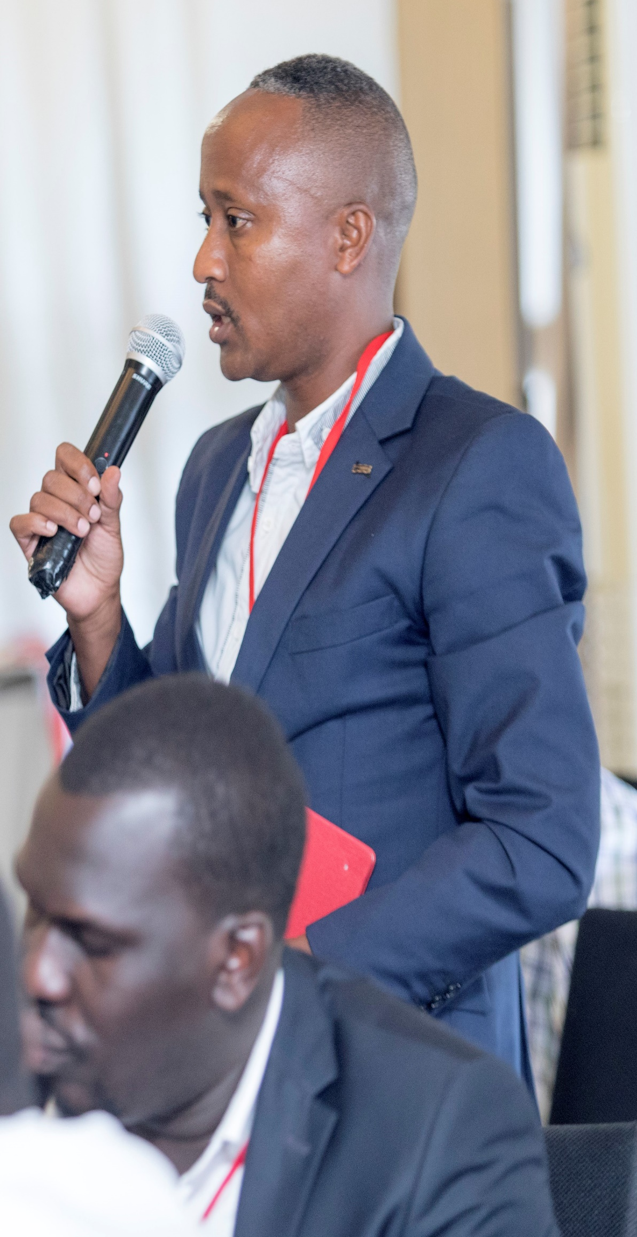
Progress to date
Private sector dialogue on carbon markets was held in Addis Ababa
Pre-COP 25 negotiators training was held in Dar Es Salaam
Eastern Africa CDM portfolio technical analysis undertaken
Launch of the Alliance website
Development of a Standardised Baseline Grid Emission Factor for Kenya – successful online stakeholder validation workshop.
Completed Workplan – based on member country’s requests
CPLC strategic partnership
Member States: Burundi, Ethiopia, Kenya, Rwanda, Tanzania, Uganda,
easternafricaalliance.org

Slide 6
What Next?
Capacity building/ Event based activities
Studies
92%
First Annual Members Meeting – May 2020
Private sector Dialogue – Session focusing on carbon pricing and carbon markets – July 2020
Pre-SB negotiators training workshop – September 2020
Collaborations with West African Alliance on Carbon Markets and Climate Finance – Potential ITMO buyer seller Roundtable, AGN Coordination, Climate Finance (June and early July)
I4C webinar on piloting Article 6 in Africa
Institutional , legal and infrastructure regional assessment for the implementation of Article 6 to be undertaken
Article 6 handbook for the Eastern Africa Region
ate resources effectively and efficiently in 27 selected partner
89%
60%
Courses
Development of Carbon pricing course, in collaboration with GIZ, with high focus on markets
In talks on possible collaboration on online carbon taxation course specific to the Eastern Africa
www.easternafricanalliance.org
Members: Uganda, Kenya, Tanzania, Rwanda, Burundi, Ethiopia
05

Slide 7
Thank You
Contact Us
secretariat@easternafricaalliance.org
Website:
www.easternafricaalliance.org
Member States: Uganda, Kenya, Tanzania, Rwanda, Burundi, Ethiopia

